Slide 1

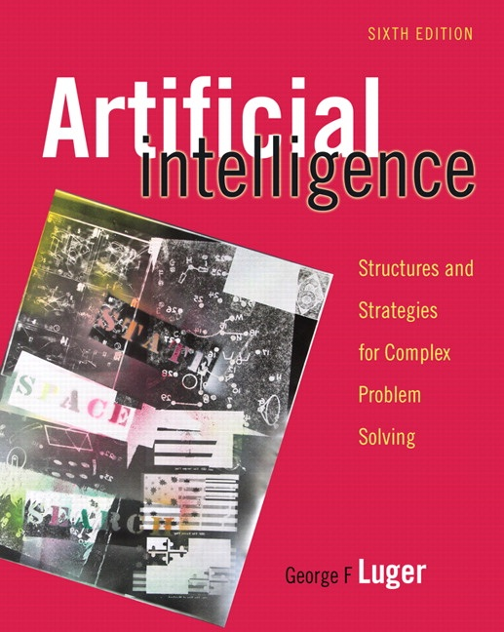
Machine Learning: Symbol-Based
10.0 Introduction
10.1 A Framework for Symbol-Based
Learning
10.2 Version Space Search
10.3 The ID3 Decision Tree Induction Algorithm
10.4 Inductive Bias and Learnability
10.5 Knowledge and Learning
10.6 Unsupervised Learning
10.7 Reinforcement Learning
10.8 Epilogue and References
10.9 Exercises
George F Luger
ARTIFICIAL INTELLIGENCE 6th edition
Structures and Strategies for Complex Problem Solving
Luger: Artificial Intelligence, 6th edition. © Pearson Education Limited, 2009
1

Slide 2
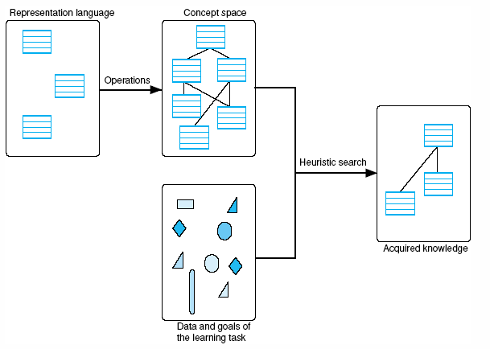
Fig 10.1 A general model of the learning process
Luger: Artificial Intelligence, 6th edition. © Pearson Education Limited, 2009
2

Slide 3
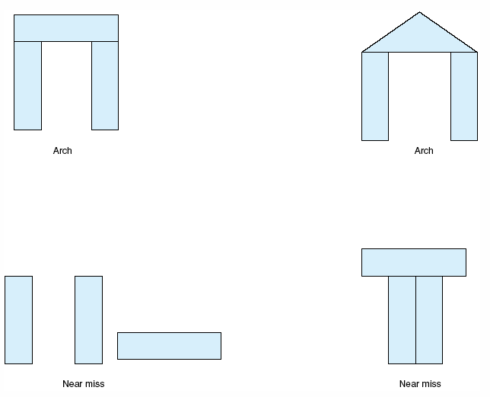
Fig 10.2 Examples and near misses for the concept “arch.”
Luger: Artificial Intelligence, 6th edition. © Pearson Education Limited, 2009
3

Slide 4
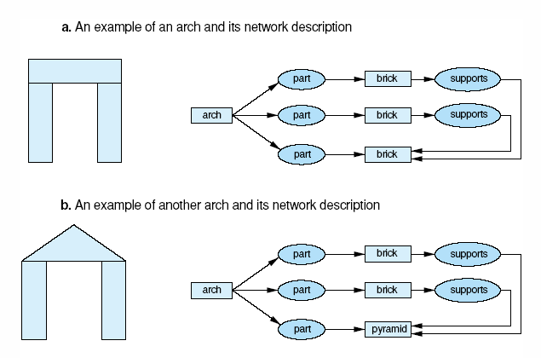
Fig 10.3 generalization of descriptions to include multiple examples.
Luger: Artificial Intelligence, 6th edition. © Pearson Education Limited, 2009
4

Slide 5
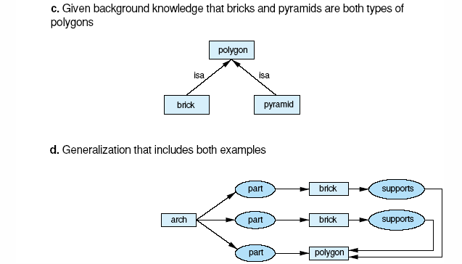
Fig 10.3 generalization of descriptions to include multiple examples (cont’d)
Luger: Artificial Intelligence, 6th edition. © Pearson Education Limited, 2009
5

Slide 6
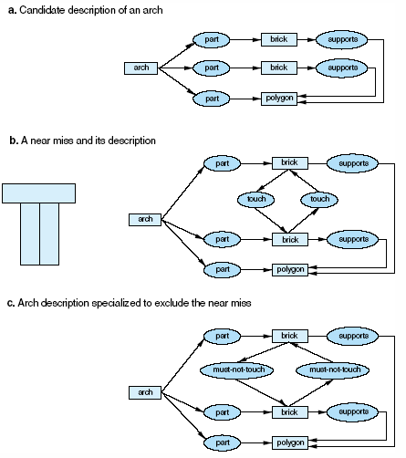
Fig 10.4 Specialization of a description to exclude a near miss. In 10.4c we add constraints to 10.4a so that it can’t match with 10.4b.
Luger: Artificial Intelligence, 6th edition. © Pearson Education Limited, 2009
6

Slide 7
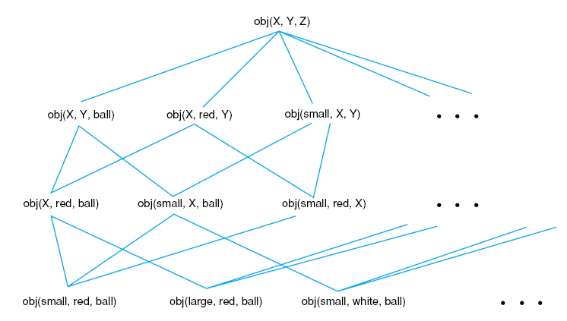
Fig 10.5 A concept space.
Luger: Artificial Intelligence, 6th edition. © Pearson Education Limited, 2009
7

Slide 8
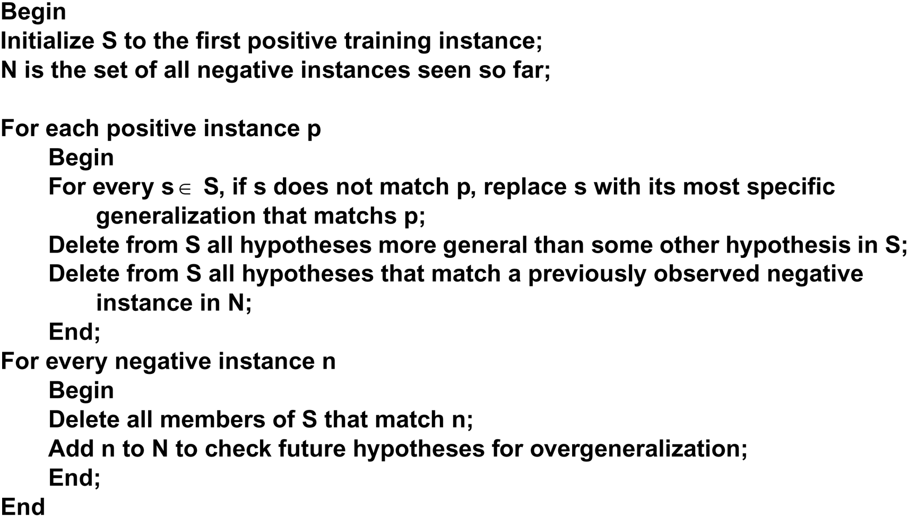
Defining specific to general search, for hypothesis set S as:
Luger: Artificial Intelligence, 6th edition. © Pearson Education Limited, 2009
8

Slide 9
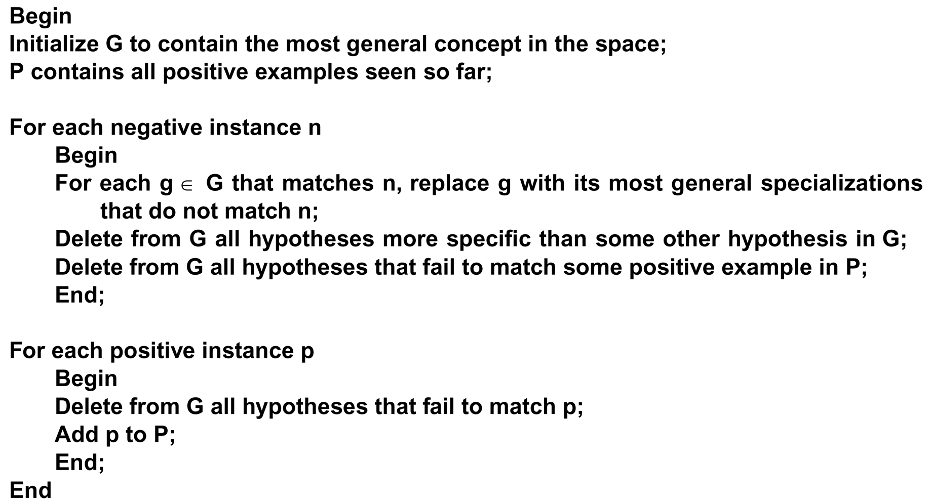
In this algorithm, negative instances lead to the specialization of candidate concepts; the algorithm uses positive instances to eliminate overly specialized concepts.
Luger: Artificial Intelligence, 6th edition. © Pearson Education Limited, 2009
9

Slide 10
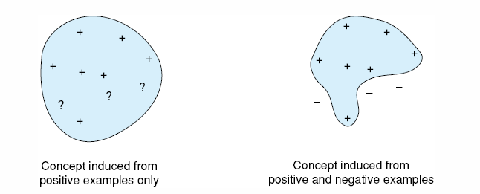
Fig 10.6 The role of negative examples in preventing overgeneralization.
Luger: Artificial Intelligence, 6th edition. © Pearson Education Limited, 2009
10

Slide 11
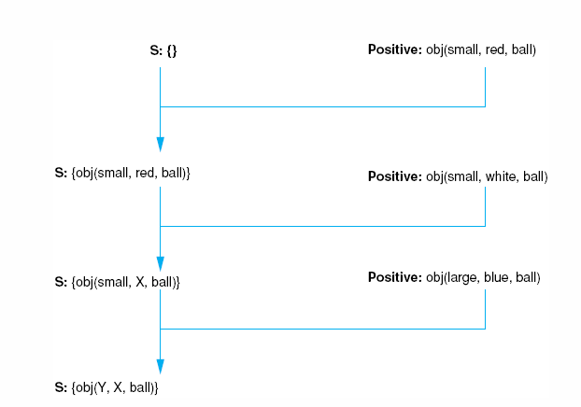
Fig 10.7 Specific to gerneral search of the version space learning the concept “ball.”
Luger: Artificial Intelligence, 6th edition. © Pearson Education Limited, 2009
11

Slide 12
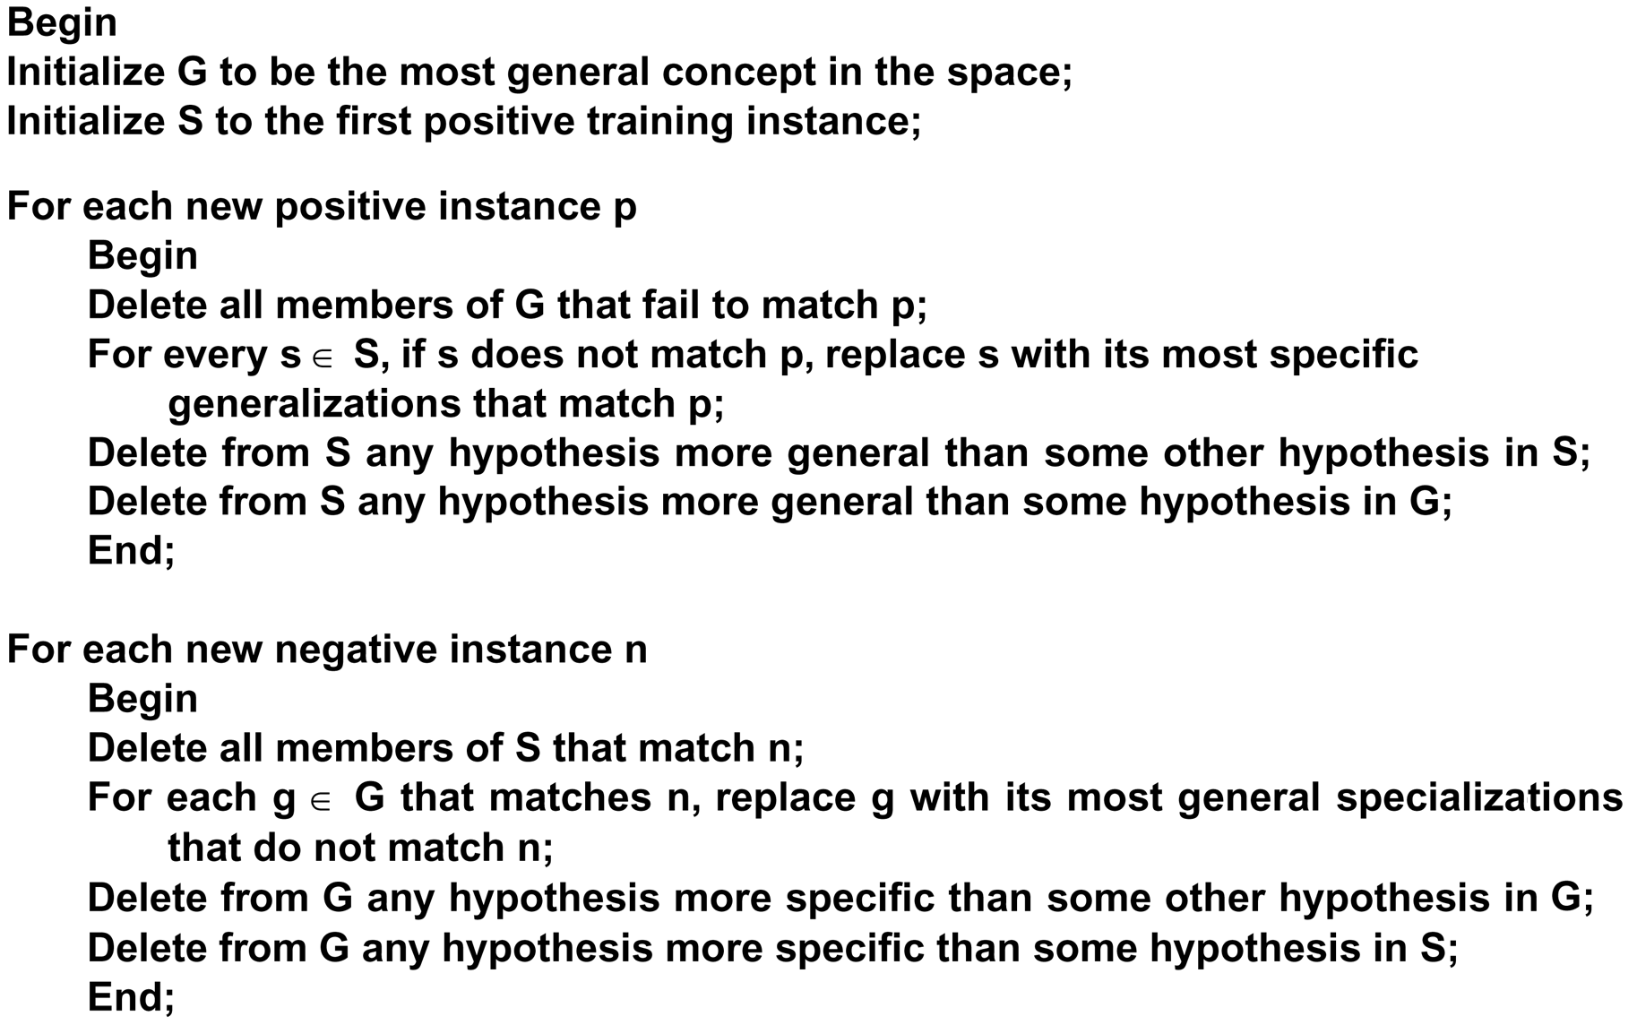
The algorithm specializes G and generalizes S until they converge on the target concept. The algorithm is defined:
Luger: Artificial Intelligence, 6th edition. © Pearson Education Limited, 2009
12

Slide 13
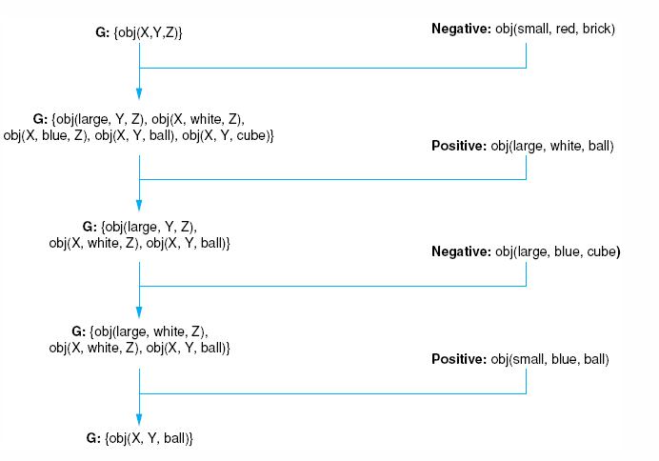
Fig 10.8 General to specific search of the version space learning the concept “ball.”
Luger: Artificial Intelligence, 6th edition. © Pearson Education Limited, 2009
13

Slide 14
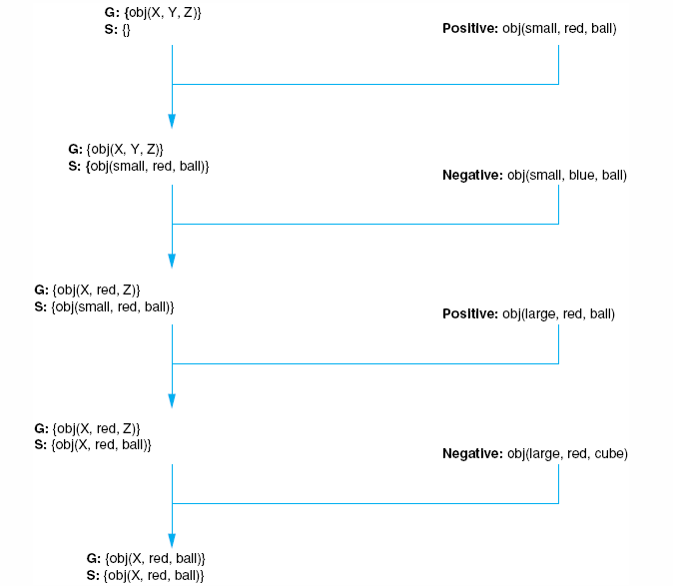
Fig 10.9 The candidate elimination algorithm learning the concept “red ball.”
Luger: Artificial Intelligence, 6th edition. © Pearson Education Limited, 2009
14

Slide 15
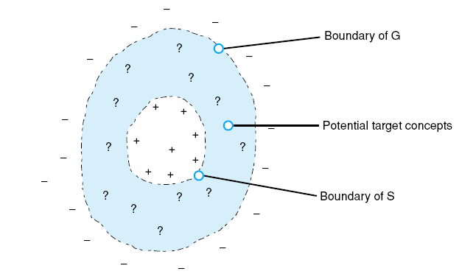
Fig 10.10 Converging boundaries of the G and S sets in the candidate elimination algorithm.
Luger: Artificial Intelligence, 6th edition. © Pearson Education Limited, 2009
15

Slide 16
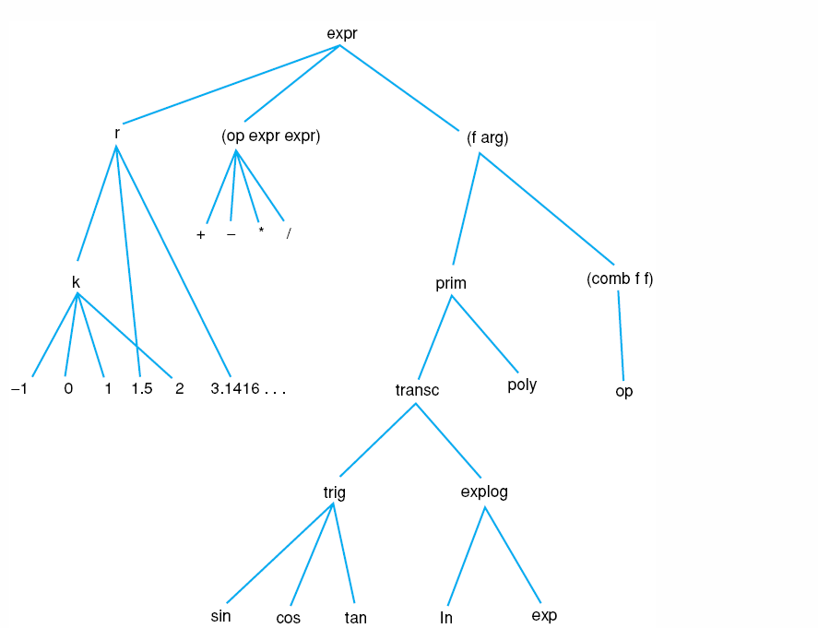
Fig 10.11 A portion of LEX’s hierarchy of symbols.
Luger: Artificial Intelligence, 6th edition. © Pearson Education Limited, 2009
16

Slide 17
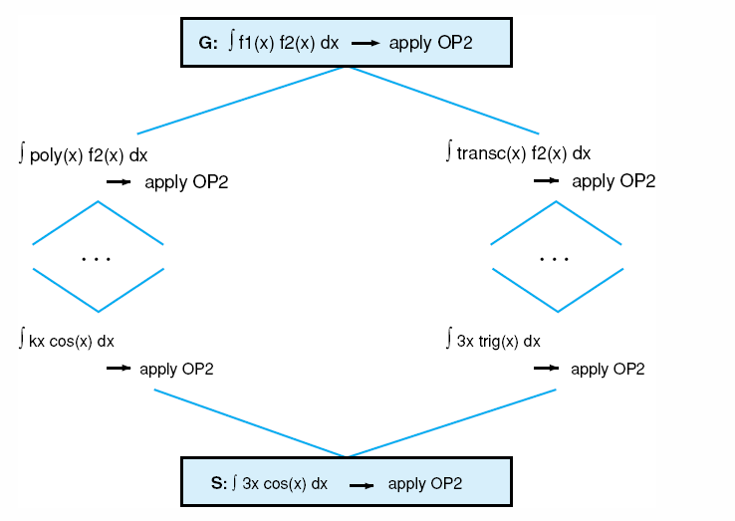
Fig 10.12 A version space for OP2, adapted from Mitchell et al. (1983).
Luger: Artificial Intelligence, 6th edition. © Pearson Education Limited, 2009
17

Slide 18
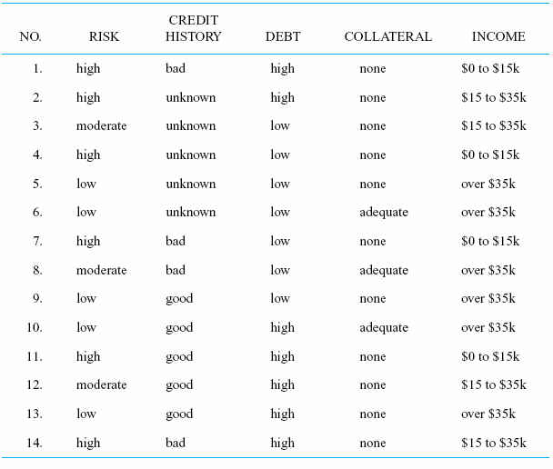
Table 10.1 Data from credit history of loan applications
Luger: Artificial Intelligence, 6th edition. © Pearson Education Limited, 2009
18

Slide 19
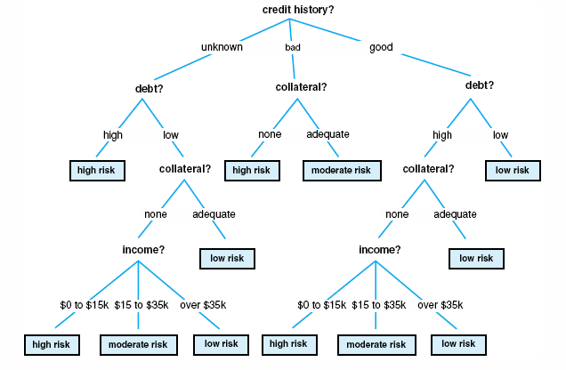
Fig 10.13 A decision tree for credit risk assessment.
Luger: Artificial Intelligence, 6th edition. © Pearson Education Limited, 2009
19

Slide 20
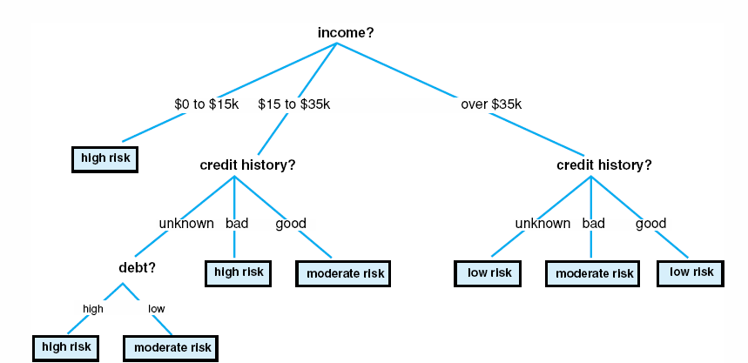
Fig 10.14 a simplified decision tree for credit risk assessment.
Luger: Artificial Intelligence, 6th edition. © Pearson Education Limited, 2009
20

Slide 21
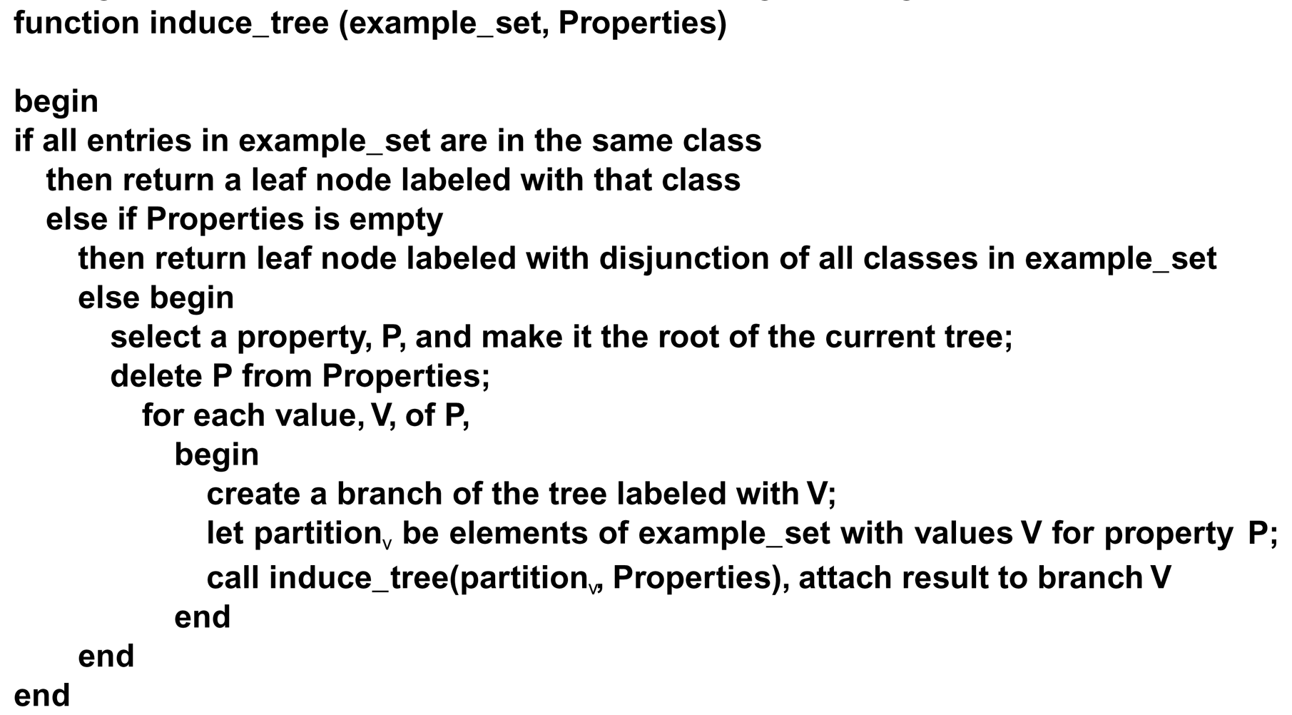
The induction algorithm begins with a sample of correctly classified members of the target categories. ID3 constructs a decision tree according to the algorithm:
Luger: Artificial Intelligence, 6th edition. © Pearson Education Limited, 2009
21

Slide 22
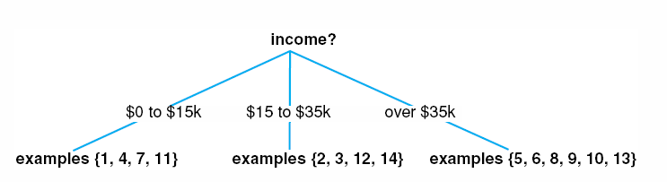
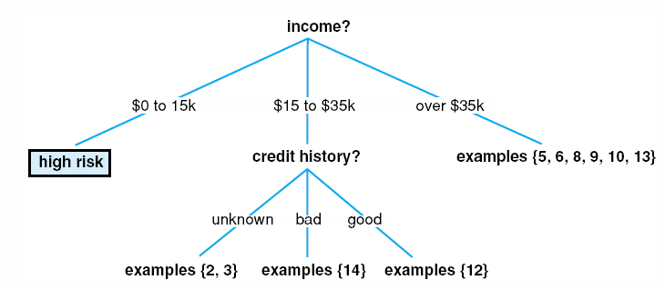
Fig 10.15 A partially constructed decision tree.
Fig 10.16 Another partially constructed decision tree.
Luger: Artificial Intelligence, 6th edition. © Pearson Education Limited, 2009
22

Slide 23
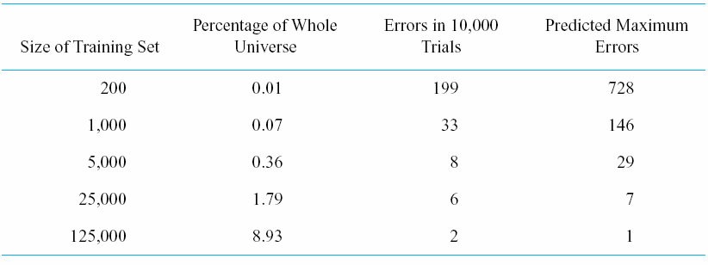
Table 10.2 The evaluation of ID3
Luger: Artificial Intelligence, 6th edition. © Pearson Education Limited, 2009
23

Slide 24
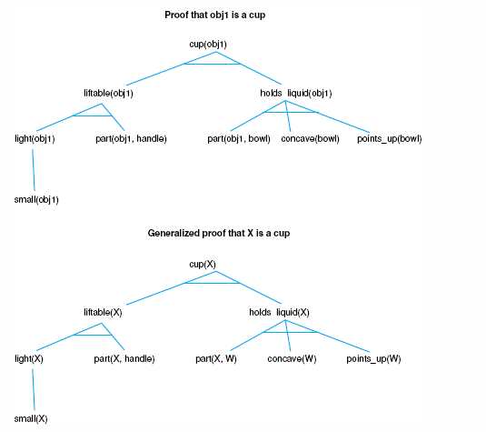
Fig 10.17 Specific and generalized proof that an object, X, is a cup.
Luger: Artificial Intelligence, 6th edition. © Pearson Education Limited, 2009
24

Slide 25
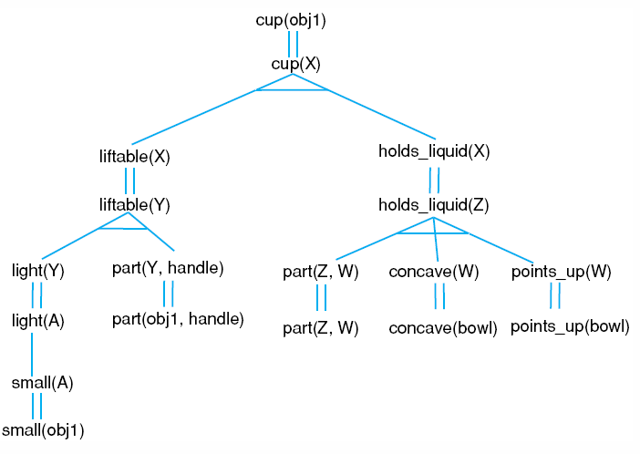
Fig 10.18 An explanation structure of the cup example.
Luger: Artificial Intelligence, 6th edition. © Pearson Education Limited, 2009
25

Slide 26
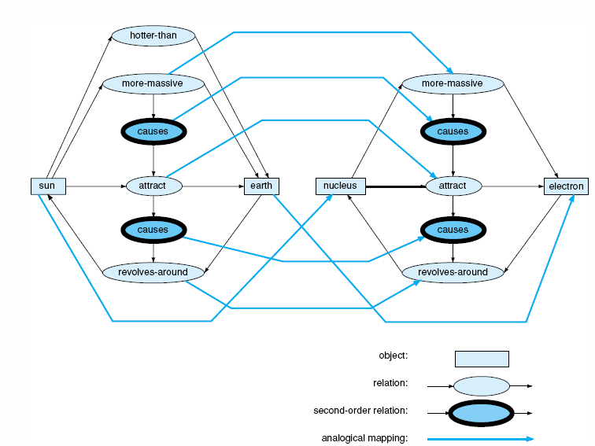
Fig 10.19 An analogical mapping.
Luger: Artificial Intelligence, 6th edition. © Pearson Education Limited, 2009
26

Slide 27
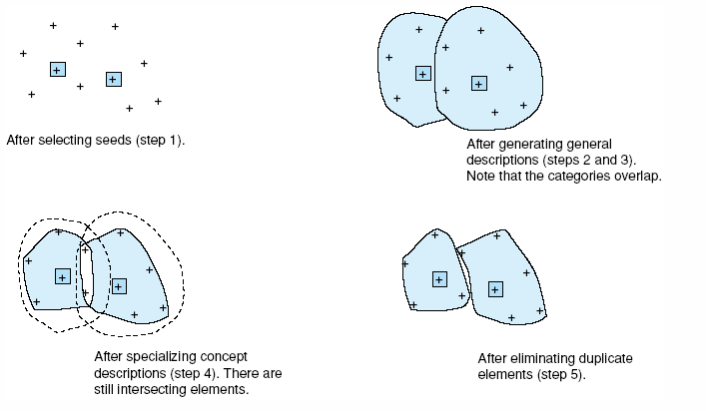
Fig 10.20 The steps of a CLUSTER/2 run.
Luger: Artificial Intelligence, 6th edition. © Pearson Education Limited, 2009
27

Slide 28
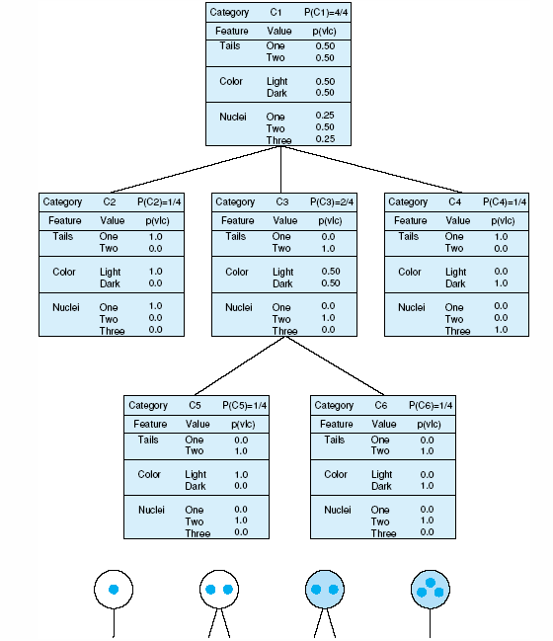
Fig 10.21 A COBWEB clustering for four one-celled organisms, adapted from Gennari et al. (1989).
Luger: Artificial Intelligence, 6th edition. © Pearson Education Limited, 2009
28

Slide 29
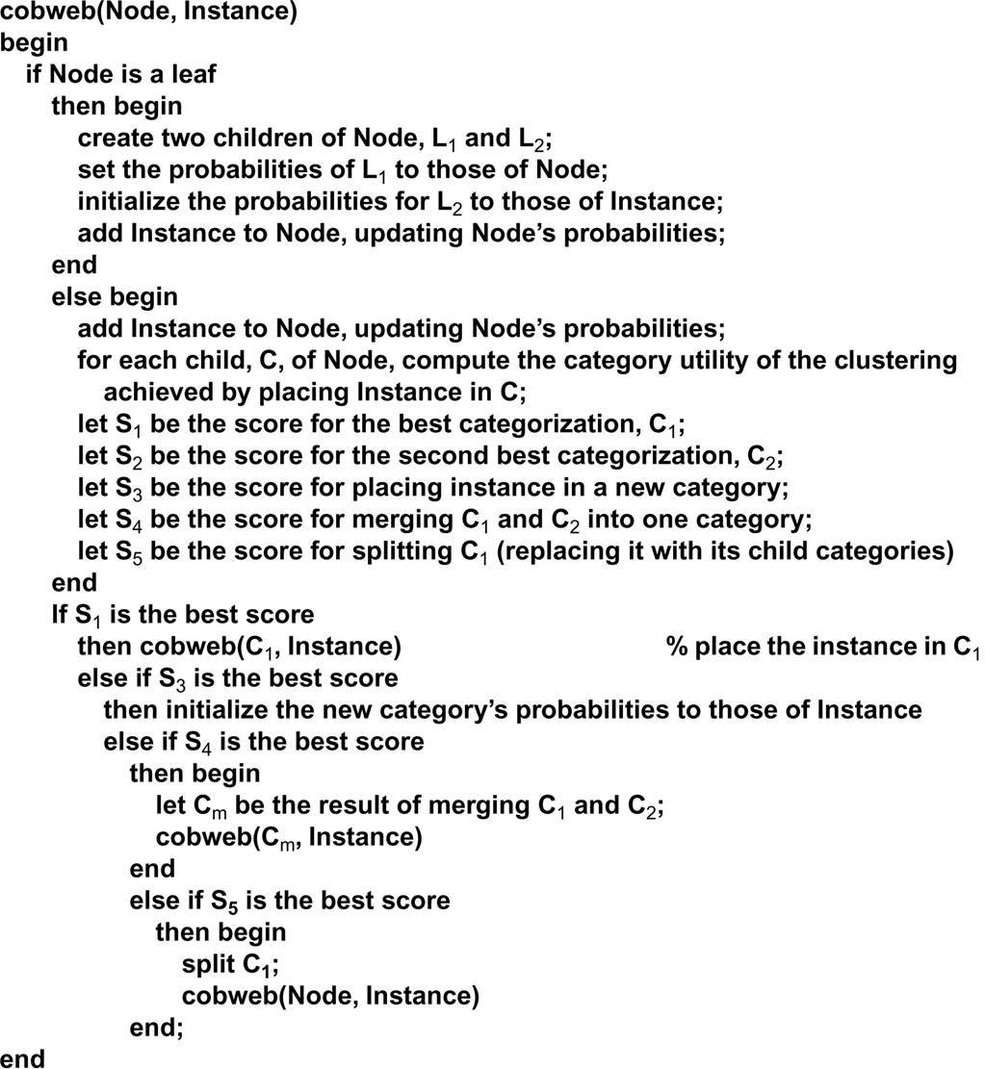
A COBWEB algorithm is defined:
Luger: Artificial Intelligence, 6th edition. © Pearson Education Limited, 2009
29

Slide 30
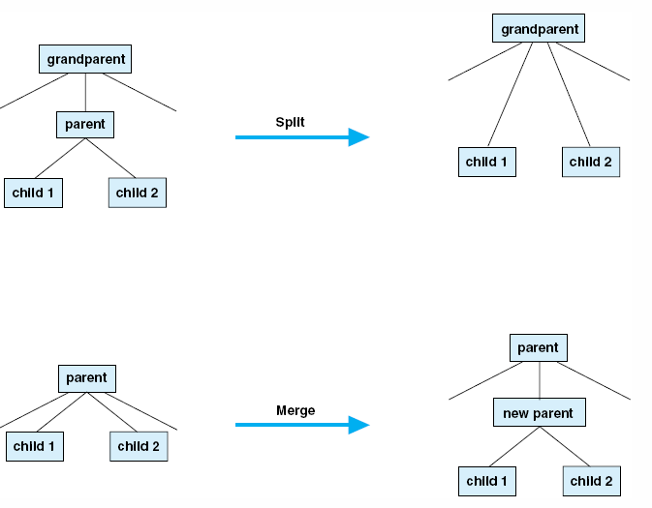
Fig 10.22 Merging and splitting of nodes.
Luger: Artificial Intelligence, 6th edition. © Pearson Education Limited, 2009
30

Slide 31
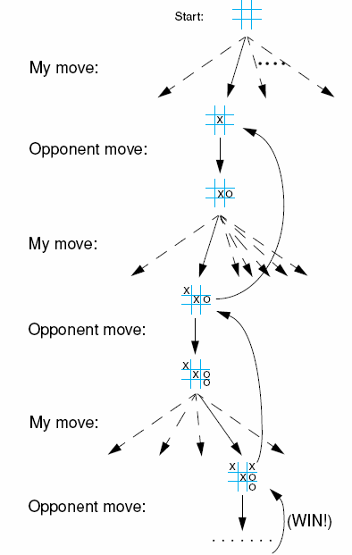
Fig 10.23 A sequence of tic-tac-toe moves. Dashed arrows indicate possible move choices, down solid arrows indicate selected moves, up solid arrows indicate reward, when reward function changes state’s value.
Luger: Artificial Intelligence, 6th edition. © Pearson Education Limited, 2009
31

Slide 32
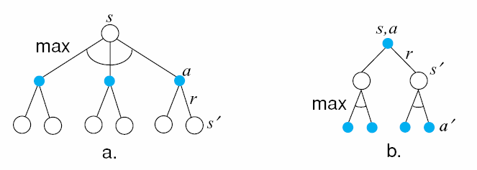
Fig 10.24 Backup diagrams for (a) V* and (b) Q*, adapted from Sutton and Barto (1998).
Luger: Artificial Intelligence, 6th edition. © Pearson Education Limited, 2009
32

Slide 33

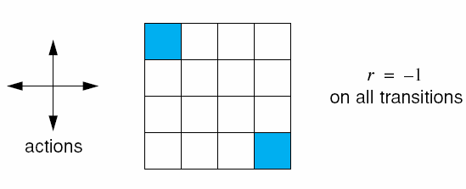
Fig 10.25 A step.
Fig 10.26 An example of a 4 x 4 grid world, adapted form Sutton and Barto (1998).
Luger: Artificial Intelligence, 6th edition. © Pearson Education Limited, 2009
33

